Slide 1
Azure Search
Azure Search

Slide 2
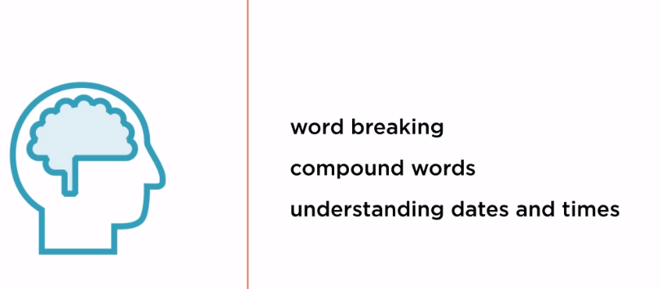
Natural Language Processing

Slide 3
